Slide 1
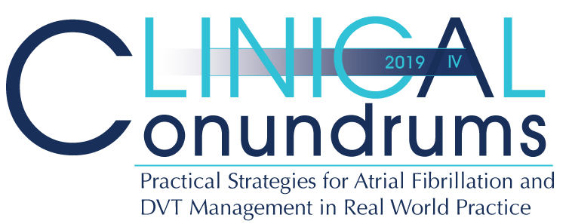



Case 4
CASE 5
Melvin
Real World Worsening Kidney Function

Slide 2

Learning Objectives
Upon completion of this activity, participants should be able to:
I
Explain the role of non-vitamin K antagonist oral anticoagulants (DOACs) in patients with chronic kidney disease (CKD)
II
Identify the clinical challenges presented by patients with worsening kidney function and transitioning from DOACs to warfarin
III
Describe the differences, advantages, and limitations among the formulae used for estimating kidney function; estimated Glomerular Filtration Rate (eGFR) and estimated Creatinine Clearance (eCrCl)

Slide 3
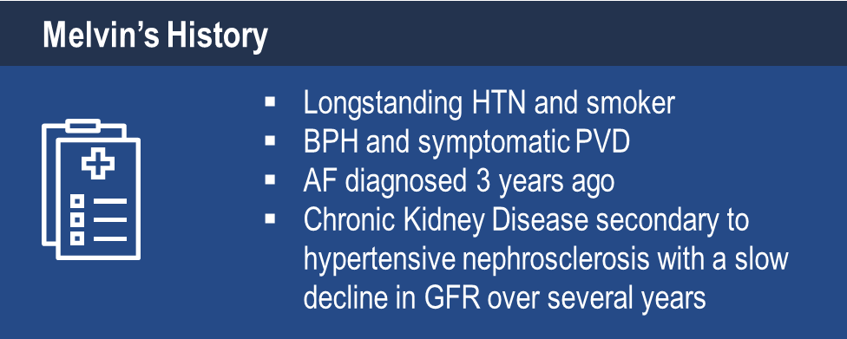
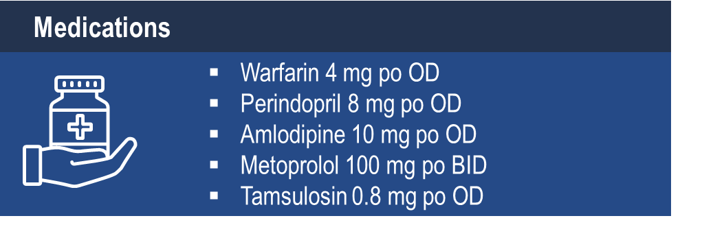
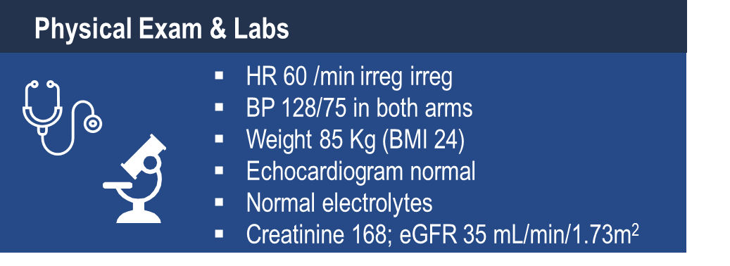
Case 4
Melvin
70 years old
Notes:
Speaker Notes:

Slide 4

Case 4
Melvin
70 years old
Melvin is becoming more weary of having blood work done regularly to monitor his INR and is keen to see if he qualifies for a different medication
Notes:
Speaker Notes:

Slide 5
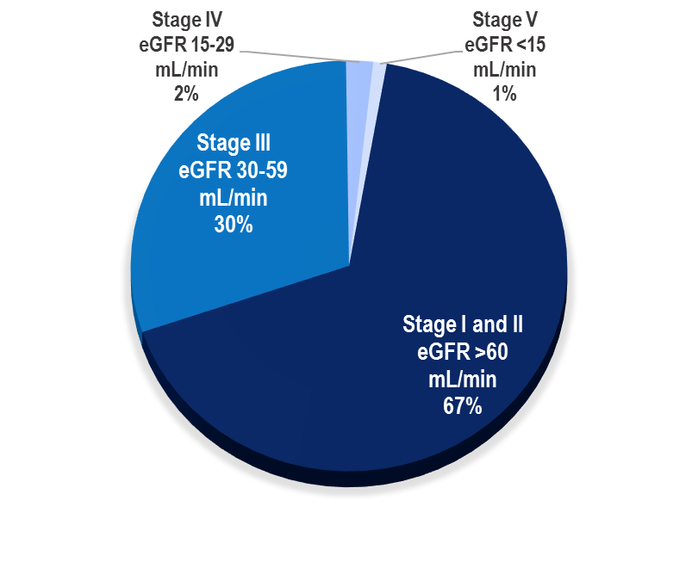
Patients with AF and Moderate Renal Impairment
1/3 patients with AF have CKD¹
Prevalence of both AF and CKD increase with age²
Frequency of CKD in AF Patients¹
Hart et al. Can J Cardiol. 2013;29:S71–78;
Olesen et al. N Engl J Med. 2012;367:625–35.
Notes:
Speaker Notes:
Renal impairment is common in patients with atrial fibrillation, with approximately 30% of these patients having moderate renal impairment.

Slide 6

What additional options does Melvin qualify for (eGFR 35)?
Select from one or more of the available options
No change, let Melvin know warfarin is the safest option for his stage of chronic kidney disease
Switch to Dabigatran 150 mg BID
Switch to Dabigatran 110 mg BID
Switch to Apixaban 5 mg BID
Switch to Apixaban 2.5 mg BID
Switch to Edoxaban 60 mg OD
Switch to Edoxaban 30 mg OD
Switch to Rivaroxaban 20 mg OD
Switch to Rivaroxaban 15 mg OD
Notes:
Speaker Notes:
Correct answers are 3. 4. 7. and 9.

Slide 7
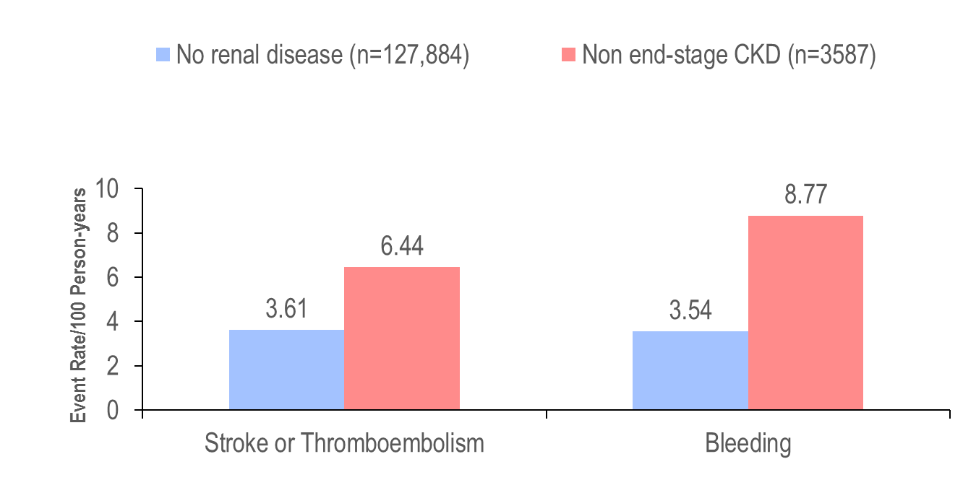
CKD is a Risk Factor for Thrombotic and Bleeding Events
Patients with AF and renal impairment ( compared to no renal impairment):*
Have a higher risk of bleeding¹
Have a higher risk of stroke¹
Are more often undertreated with warfarin²
*vs. normal renal function.
Olesen et al. N Engl J Med. 2012;367:625–35;
Capodanno et al. Circulation. 2012;125:2649–61.
Notes:
Speaker Notes:
Chronic kidney disease is a risk factor for thrombotic and bleeding events, with greater increases in stroke and systemic embolism (3.61 vs. 6.44 events/100 person-years; hazard ratio: 1.49; 95% CI: 1.38-1.59) and bleeding (3.54 vs. 8.77 events/100 person-years; hazard ratio: 2.24; 95% CI: 2.10-2.38) for patients with no renal disease compared to those with non-end-stage chronic kidney disease.

Slide 8
Kidney Function Calculations Backgrounder
What is the eGFR (estimated Glomerular Filtration Rate)?
GFR cannot be measured directly (clinically) so must be estimated indirectly.
The GFR is the volume of fluid filtered from the renal glomerular capillaries into Bowman's capsule per unit time and it is the most accurate indicator of glomerular function.
The “eGFR” is an estimated value derived from a measured serum creatinine using formulae that adjust for age, gender, and ethnicity.
What are the formulas to estimate GFR?
Cockcroft-Gault Formula estimates creatinine clearance (CrCl)– less accurate than MDRD and CKD-EPI – BUT used in all the RCTs of DOACs vs warfarin
MDRD (Modification of Diet in Renal Disease Study) – used until recently in Canada
CKD-EPI (Chronic Kidney Disease Epidemiology Collaboration) - replacing MDRD formula in Canada
*Clin J Am Soc Nephrol 2010;5:1003–1009.
Notes:
Speaker Notes:
Speaker can chose to show and discuss or hide this as well as the following slide depending on the audience’s needs
Key Points:
eGFR and CrCl are not interchangeable and may differ substantially particularly in patients with small body size
The Thrombosis Canada app’s - Tools section has a simple to use formula for quickly estimating CrCl from gender, age, weight and creatinine.
At a creatinine of 200 mmol/L, Melvin’s eGFR is 35 and his calculated CrCl is 36 ml/min (almost the same)
DOAC dosage adjustments are based on based on CrCl and not eGFR.

Slide 9
Kidney Function Calculations Backgrounder
Why report the eGFR?
The eGFR is the simplest, most accurate, and inexpensive test for kidney function that is available today and is the common “starting point” for the Clinical Practice Guidelines that deal with CKD
All endogenous filtration markers have non-GFR determinants that affect interpretation of their accuracy as well as prediction of risk
Why is the CKD-EPI formula replacing the MDRD Equation for estimate GFR in Canada?
CKD-EPI formula is more accurate than the MDRD Study equation
There is less bias at eGFR >60 ml/min/1.73m²
Similar performance at eGFR <60 ml/min/1.73m²
Endorsed by the Canadian Society of Nephrology (CSN)
Replacing the older MDRD formula in many Provinces (i.e. Ontario, BC, Alberta, Manitoba)
*Clin J Am Soc Nephrol 2010;5:1003–1009.
Notes:
Speaker Notes:
Speaker can chose to show and discuss or hide this as well as the following slide depending on the audience’s needs
Absolute creatinine of 133 mmol/L is used in the “ABC” criteria for apixaban dosage adjustment from 5 mg bid to 2.5 mg bid. Calculation of eGFR or CrCl was NOT required in the RCTs (ARISTOTLE and AVEROES). Applying the two of three “ABC” criteria may thus be simpler than with the other three DOACs.
While Canadian laboratories generally provide an eGFR using the CKD-EPI equation, DOAC RCTs used CrCl calculated with the Cockgroft Gault equation for dosage adjustment.
Physicians prescribing an anti Xa inhibitor (rivaroxaban, dabigatran, edoxaban) can use the Thrombosis Canada “Tools” app to readily calculate CrCl from gender, age, weight (Kg) and creatinine (mmol/L).
apixaban dosing is independent of eGFR, i.e. dependent on absolute Cr concentration, so in a way simpler since the other DOACS RCTs used cockloft gault but current lab reports use CKD Epi, not the same

Slide 10
Stroke Prevention in AF: Clinical Pharmacology and Dosing of DOACs
 | Apixaban ^{(eliquis)} | Dabigatran ^{(Pradaxa)} | EDOXABAN ^{(lixiana)} | Rivaroxaban ^{(Xarelto)}
Mechanism of action | Direct Factor Xa inhibitor | Direct thrombin inhibitor | Direct Factor Xa inhibitor | Direct Factor Xa inhibitor
Oral bioavailability | ~50% | ~6.5% | 62% | 80-100%
Pro-drug | No | Yes | No | No
Food effect | No | No | No | Yes (needs to be taken with food)
Renal clearance | ~27% | 85% | 50% | 36% *
Mean half-life (t_{1/2}) | ~12 h | 11-17h | 10-14h | 5-13 h
T_{max} | 3-4 h | 0.5-2 h | 1-2h | 2-4 h
Recommended daily dose | 5 mg BID | 150 mg BID | 60 mg QD | 20 mg QD
Pfizer Canada Inc./BMS Canada. Eliquis (apixaban) Product Monograph, June 16, 2016.
Boehringer Ingelheim Canada Ltd. Pradaxa (dagbatran) Product Monograph. August 11, 2016.
Bayer Inc. Xarelto (rivaroxaban) Product Monograph. July 20, 2015.
Daiichi Sankyp Inc. Lixiana (edoxaban) Product Monograph. November 2, 2016.
* Rivaroxaban is 66% renally cleared and its active metabolite is 36% renally cleared
Notes:
Speaker Notes:
DOACs can be differentiated based on efficacy and bleeding risk in the clinical trials ( and real-world experience available and forthcoming…) with the limitations of indirect clinical comparisons duly acknowledged. DOACs can also be differentiated based on other factors as summarized in this slide. Parameters such as borderline renal function, sensitivity to dyspepsia, irregular food intake, need for blister pack medication preparation by pharmacist, cognitive dysfunction and medication non compliance to BID dosing etc etc can determine selection of the best agent for a given patient!
The Tmax of all DOACs is a short 2-4 hours. This means that, unlike with warfarin, a patient is rapidly anticoagulated within just two hours following a DOAC dose. This has important implications for heparin “bridging” which is no longer required with DOACs as well as for the timing of resumption of DOAC therapy following procedures.
All DOACs share a short 12 hour half-life in the setting of preserved renal function (CrCl > 60 ml/min). This is a major advantage over warfarin which has a half-life of 36 hours or longer depending on hepatic function. Most procedures at intermediate or high bleeding risk can be performed within 1-2 days respectively of withholding a DOAC with additional delay required with renal dysfunction. Moreover, major bleeding can usually be controlled with local and supportive measures as the effect of the DOAC wears off quickly. Specific DOAC antidotes are therefore rarely required.

Slide 11
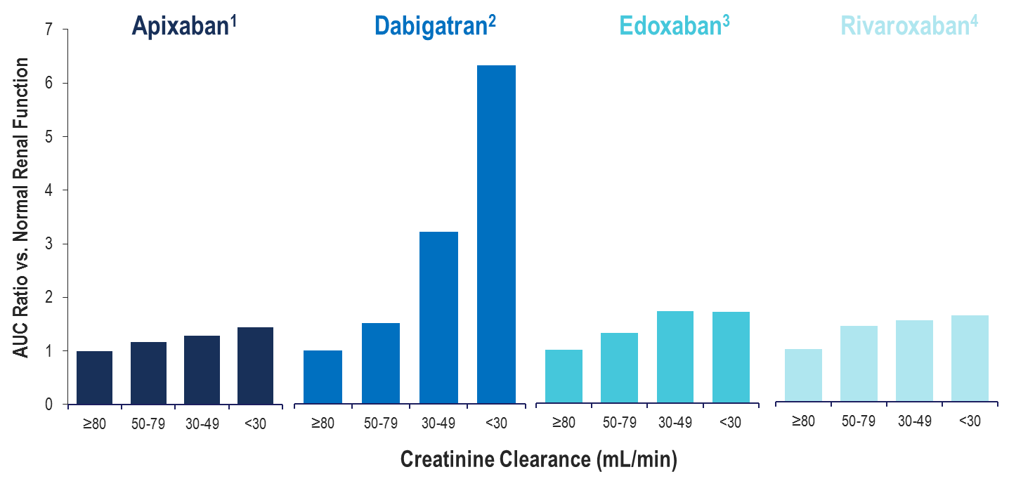
Total Drug Exposure (AUC) with Declining Renal Function
CL_{R}27%
CL_{R}85%
CL_{R}50%
CL_{R}33%
Normal Renal Function: ≥80 mL/min; Mild Renal Impairment: 50-79 mL/min
Moderate Renal Impairment: 30-49 mL/min; Severe Renal Impairment: <30 mL/min
Apixaban (Eliquis) Product Monograph. Bristol-Meyers Squibb Canada;
Dabigatran (Pradaxa) Product Monograph. Boehringer Ingelheim Canada Ltd.;
Edoxaban (Lixiana) Product Monograph. Progress Therapeutics;
Rivaroxaban (Xarelto) Product Monograph. Bayer Inc.
Notes:
Speaker Notes:
Altered renal elimination of the DOACs impacts drug exposure. Increased drug exposure is observed with declining renal function, with dabigatran being impacted to the greatest extent.

Slide 12
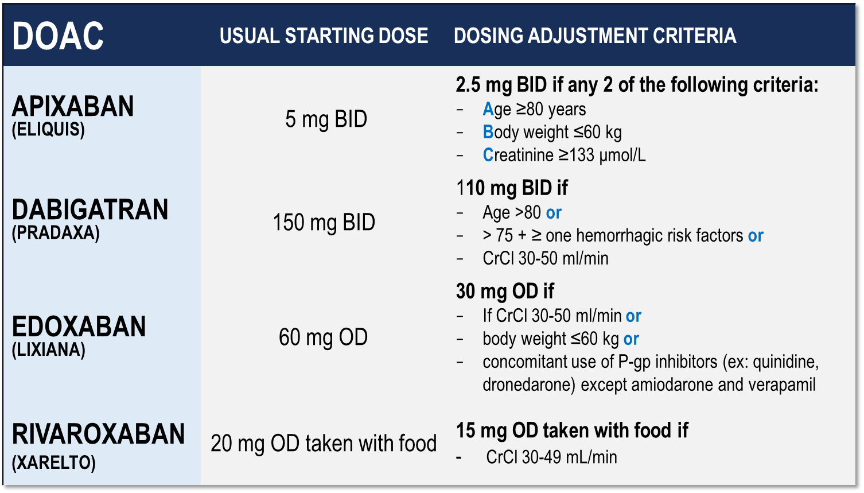
Considerations for Dosing of DOACs
Pfizer Canada Inc./BMS Canada. Eliquis (apixaban) Product Monograph, 2018.
Boehringer Ingelheim Canada Ltd. Pradaxa (dagbatran) Product Monograph. August 11, 2016.
Bayer Inc. Xarelto (rivaroxaban) Product Monograph. 2018.
Daiichi Sankyp Inc. Lixiana (edoxaban) Product Monograph. 2017.
Notes:
Speaker Notes:
Indispensable slide summarizing the criteria for a dosage adjustment from the default higher dosage for the different DOACs currently available in Canada
CrCl is calculated using the Cockgroft Gault formula

Slide 13
How Often Should We Measure Renal Function?
For patients with renal dysfunction, kidney function should be measured:
eGFR of 15-30 ml/min/1.73 m²: every 3 months
eGFR of 30-60 ml/min/1.73 m² : every 6 months
eGFR of > 60 ml/min/1.73 m² : every 12 months
Canadian Journal of Cardiology; 2015:31;1207-1218
Notes:
Speaker Notes:
Initiation of DOAC is not generally recommended in Canada below an eGFR of 30 ml/min/1.73 m^{2.} However, some AF patients with CRF have period of acute exacerbation when their GFR drops transiently below 30 ml/min/1.73m². Since some DOACs have a low renal elimination rate (e.g. apixaban = 25%), many will feel comfortable continuing them in this setting while carefully monitoring renal function at least every 3 months or even more frequently in some cases. The reasoning is that there is an even greater risk of bleeding on warfarin in stage 4-5 CRF than on a DOAC with low renal clearance. It is important for the speaker to highlight that the foregoing is based on the pharmacokinetic properties of DOACs and that these advanced renal failure patients with low GFR under 25 ml/min/1.73 m² were excluded from the pivotal DOAC vs warfarin trials. (AUTHOR’S OPINION)
Absolute creatinine of 133 mmol/L is used in the “ABC” criteria for apixaban dosage adjustment from 5 mg bid to 2.5 mg bid. Calculation of eGFR or CrCl was NOT required in the RCTs (ARISTOTLE and AVEROES). Applying the two of three “ABC” criteria may thus be simpler than with the other three DOACs.
While Canadian laboratories generally provide an eGFR using the CKD-EPI equation, DOAC RCTs used CrCl calculated with the Cockgroft Gault equation for dosage adjustment.
Physicians prescribing an anti Xa inhibitor (rivaroxaban, dabigatran, edoxaban) can use the Thrombosis Canada “Tools” app to readily calculate CrCl from gender, age, weight (Kg) and creatinine (mmol/L).
apixaban dosing is independent of eGFR, i.e. dependent on absolute Cr concentration, so in a way simpler since the other DOACS RCTs used cockloft gault but current lab reports use CKD Epi, not the same

Slide 14
Reviewing the Data: Apixaban
Outcomes in ARISTOTLE According to Renal Function
 | Apixaban | Warfarin | Hazard Ratio (95% CI) | P value Interaction
 | Number of events (%/yr)
Stroke / SE |  |  |  | : 0.705
eCrCl >80 mL/min* | 0.99% (70) | 1.12% (79)
eCrCl >50-80 mL/min† | 1.24% (87) | 1.69% (116)
eCrCl ≤50 mL/min‡ | 2.11% (54) | 2.67% (69)
Major bleeding |  |  |  | : 0.03
eCrCl >80 mL/min* | 1.46% (96) | 1.84% (119)
eCrCl >50-80 mL/min† | 2.45% (157) | 3.21% (199)
eCrCl ≤50 mL/min‡ | 3.21% (73) | 6.44% (142)
N=7,518
0.25
0.5
1.00
1.5
2.0
Apixaban better
Warfarin better
*n=7518 (41%); †n=7587 (42%); ‡n=3017 (17%) Results were consistent regardless of methods for GFR estimation Hohnloser SH et al. Eur Heart J 2012; 22:2821-30.
Notes:
Speaker Notes:
Reviewing the data: Outcomes of Apixaban
ARISTOTLE according to renal function
No interactions between levels of CrCl (<50, 50-80, >80) and the efficacy or bleeding risk of DOACs vs. warfarin, but RRR of major bleeding with apixaban vs. warfarin significantly greater when CrCl ≤50

Slide 15
Reviewing the Data: Dabigatran
Outcomes of Dabigatran 110 mg BID & 150 mg BID in RE-LY According to Renal Function
 | Hazard Ratio (95% CI) Dabi 110 vs. Warfarin | P value Interaction | Hazard Ratio (95% CI) Dabi 150 vs. Warfarin | P value Interaction
Stroke / SE |  | : 0.911 |  | : 0.752
eCrCl ≥80 mL/min*
eCrCl 50-<80 mL/min†
eCrCl <50 mL/min‡
Major bleeding |  | : 0.061 |  | : 0.639
eCrCl ≥80 mL/min*
eCrCl 50-<80 mL/min†
eCrCl <50 mL/min‡
0.25
0.5
1.00
1.5
2.0
0.25
0.5
1.00
1.5
2.0
Dabi 110 better
Warfarin better
Dabi 150 better
Warfarin better
N= 18,113
*n=5844 (32.6%); † n=8553 (47.6%); ‡ n=3554 (19.8%)
Results were consistent regardless of methods for GFR estimation Hijazi Z et al. Circulation 2014; 129:961-70.
Notes:
Speaker Notes:
Reviewing the data: Outcomes of Dabigatran 110 & 150 mg
RE-LY according to renal function

Slide 16
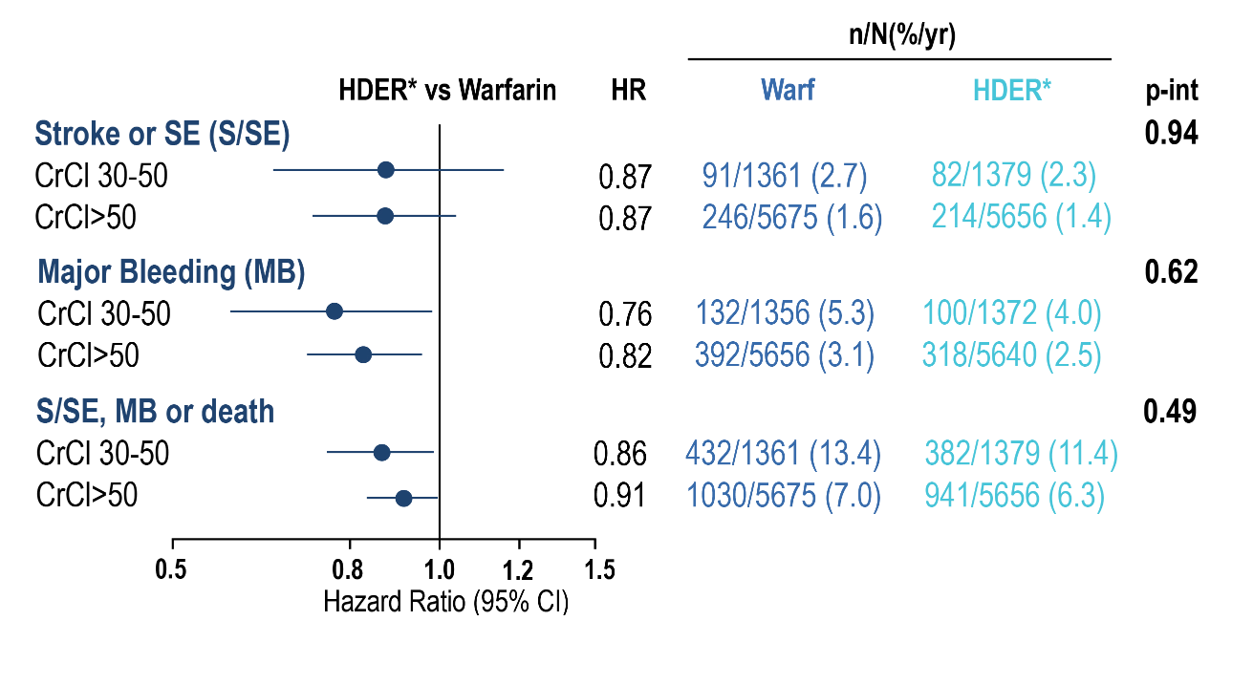
Reviewing the Data: Edoxaban
Outcomes in the ENGAGE AF-TIMI 48 Trial According to Renal Function
Warfarin HDER*
91/1361 (2.7)
246/5675 (1.6)
82/1379 (2.3)
214/5656 (1.4)
132/1356 (5.3)
392/5656 (3.1)
100/1372 (4.0)
318/5640 (2.5)
432/1361 (13.4)
1030/5675 (7.0)
382/1379 (11.4)
941/5656 (6.3)
Favours HDER*
Favours Warfarin
*HDER of 60 mg daily or 30 mg daily if dose reduced for creatinine clearance (CrCl) ≤50 mL/min, weight ≤60 kg, or potent phosphorylated glycoprotein inhibitor use.
Impact of Renal Function on Outcomes With Edoxaban in the ENGAGE AF-TIMI 48 Trial, Volume: 134, Issue: 1, Pages: 24-36, DOI: (10.1161/CIRCULATIONAHA.116.022361)
Notes:
Speaker Notes:
Data for the efficacy and net clinical outcome analyses are from the intention-to-treat population for the overall study period. Data for safety are from the safety cohort for the treatment period with interval censoring of events during study-drug interruptions that lasted >3 days. CrCl (mL/min) at randomization was estimated with the Cockcroft-Gault equation. CI indicates confidence interval; HDER, higher-dose edoxaban regimen; HR, hazard ratio; P-int, P for interaction for treatment by renal subgroup; and S/SE, stroke or systemic embolism. *HDER of 60 mg daily or 30 mg daily if dose reduced for creatinine clearance (CrCl) ≤50 mL/min, weight ≤60 kg, or potent phosphorylated glycoprotein inhibitor use.

Slide 17
Reviewing the Data: Rivoraxaban
Outcomes in ROCKET-AF According to Renal Function
 | Rivaroxaban | Warfarin | Hazard Ratio (95% CI) | P value Interaction
 | Number of events per 100 pt-yrs
Stroke / SE |  |  |  | : 0.76
eCrCl ≥50 mL/min* | 1.57 | 2.00
eCrCl 30-49 mL/min† | 2.32 | 2.77
Major bleeding |  |  |  | : 0.48
eCrCl ≥50 mL/min* | 3.39 | 3.17
eCrCl 30-49 mL/min† | 4.49 | 4.70
0.25
0.5
1.00
1.5
2.0
N= 14,264
Rivaroxaban better
Warfarin better
*rivaroxaban 20 mg (n=5637; 79%); †rivaroxaban 15 mg (n=1474; 21%); per protocol population Fox KAA et al. Eur Heart J 2011; 32:2387-94
Notes:
Speaker Notes:
Reviewing the data: Outcomes of Rivaroxaban
ROCKET-AF according to renal function

Slide 18
Case 4
What if Melvin’s eGFR is 30 mL/min/1.73 m²
Notes:
Speaker Notes:

Slide 19
What additional options does Melvin qualify for (eGFR 30)?
Select from one or more of the available options
No change, let Melvin know warfarin is the safest option for his stage of chronic kidney disease
Switch from Dabigatran 150 mg BID
Switch from Dabigatran 110 mg BID
Switch to Apixaban 5 mg BID
Switch to Apixaban 2.5 mg BID
Switch to Edoxaban 60 mg OD
Switch to Edoxaban 30 mg OD
Switch to Rivaroxaban 20 mg OD
Switch to Rivaroxaban 15 mg OD
Notes:
Speaker Notes:
Correct answers are 4 and 9

Slide 20
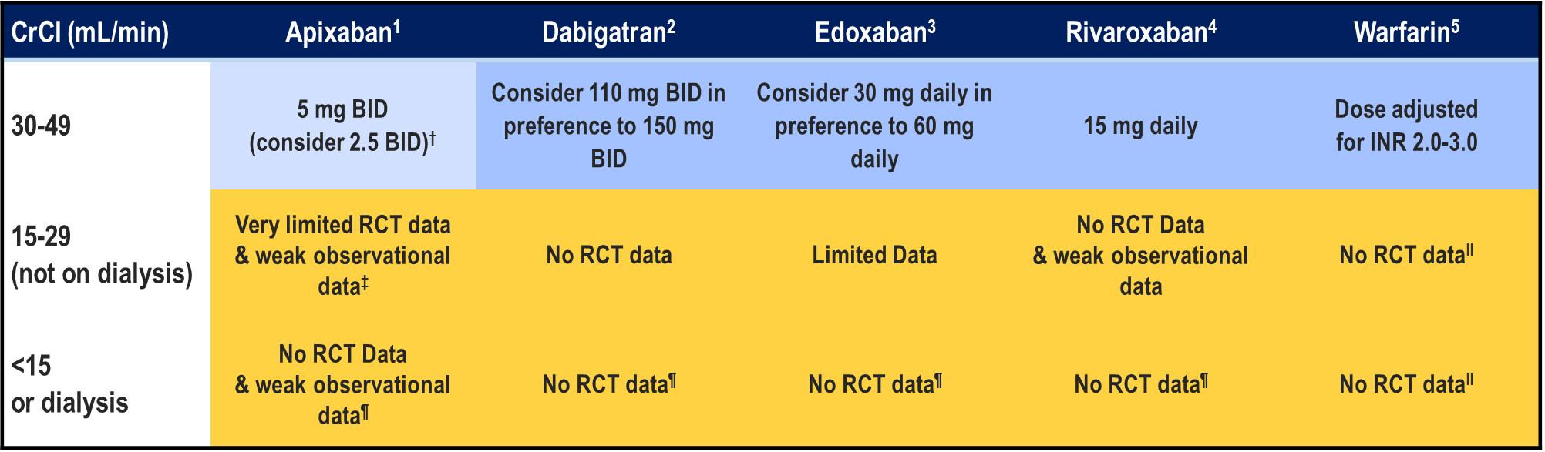
Limited evidence for DOACs in AF patients with Advanced (stages 4-5) CRF
Pfizer Canada Inc./BMS Canada. Eliquis (apixaban) Product Monograph, 2018.
Boehringer Ingelheim Canada Ltd. Pradaxa (dagbatran) Product Monograph. August 11, 2016.
Bayer Inc. Xarelto (rivaroxaban) Product Monograph. 2018.
Daiichi Sankyp Inc. Lixiana (edoxaban) Product Monograph. 2017.
Notes:
Speaker Notes:
The DOACs are at least partially eliminated by the kidneys. Dabigatran and edoxaban have the greatest dependence on renal elimination (~85% and 50%, respectively),^{8, 9} whereas 27% and 33% of apixaban and rivaroxaban, respectively, are renally cleared as unchanged drug.

Slide 21
Case 4
It’s 3 years later. Melvin is now 73 years old and his eGFR is 20 mL/min/1.73 m²
Notes:
Speaker Notes:

Slide 22
How would you adjust Melvin’s anticoagulation strategy for his atrial fibrillation?(eGFR 20)?
Select from one or more of the available options
Let Melvin know warfarin is the safest option for his stage of chronic kidney disease
Use Dabigatran 150 mg BID
Use Dabigatran 110 mg BID
Use Apixaban 5 mg BID
Use Apixaban 2.5 mg BID
Use Edoxaban 60 mg OD
Use Edoxaban 30 mg OD
Use Rivaroxaban 20 mg OD
Use Rivaroxaban 15 mg OD
Notes:
Speaker Notes:
Possible correct responses include 1. 5. and 9. A discussion of benefit vs risk is needed with the patient

Slide 23
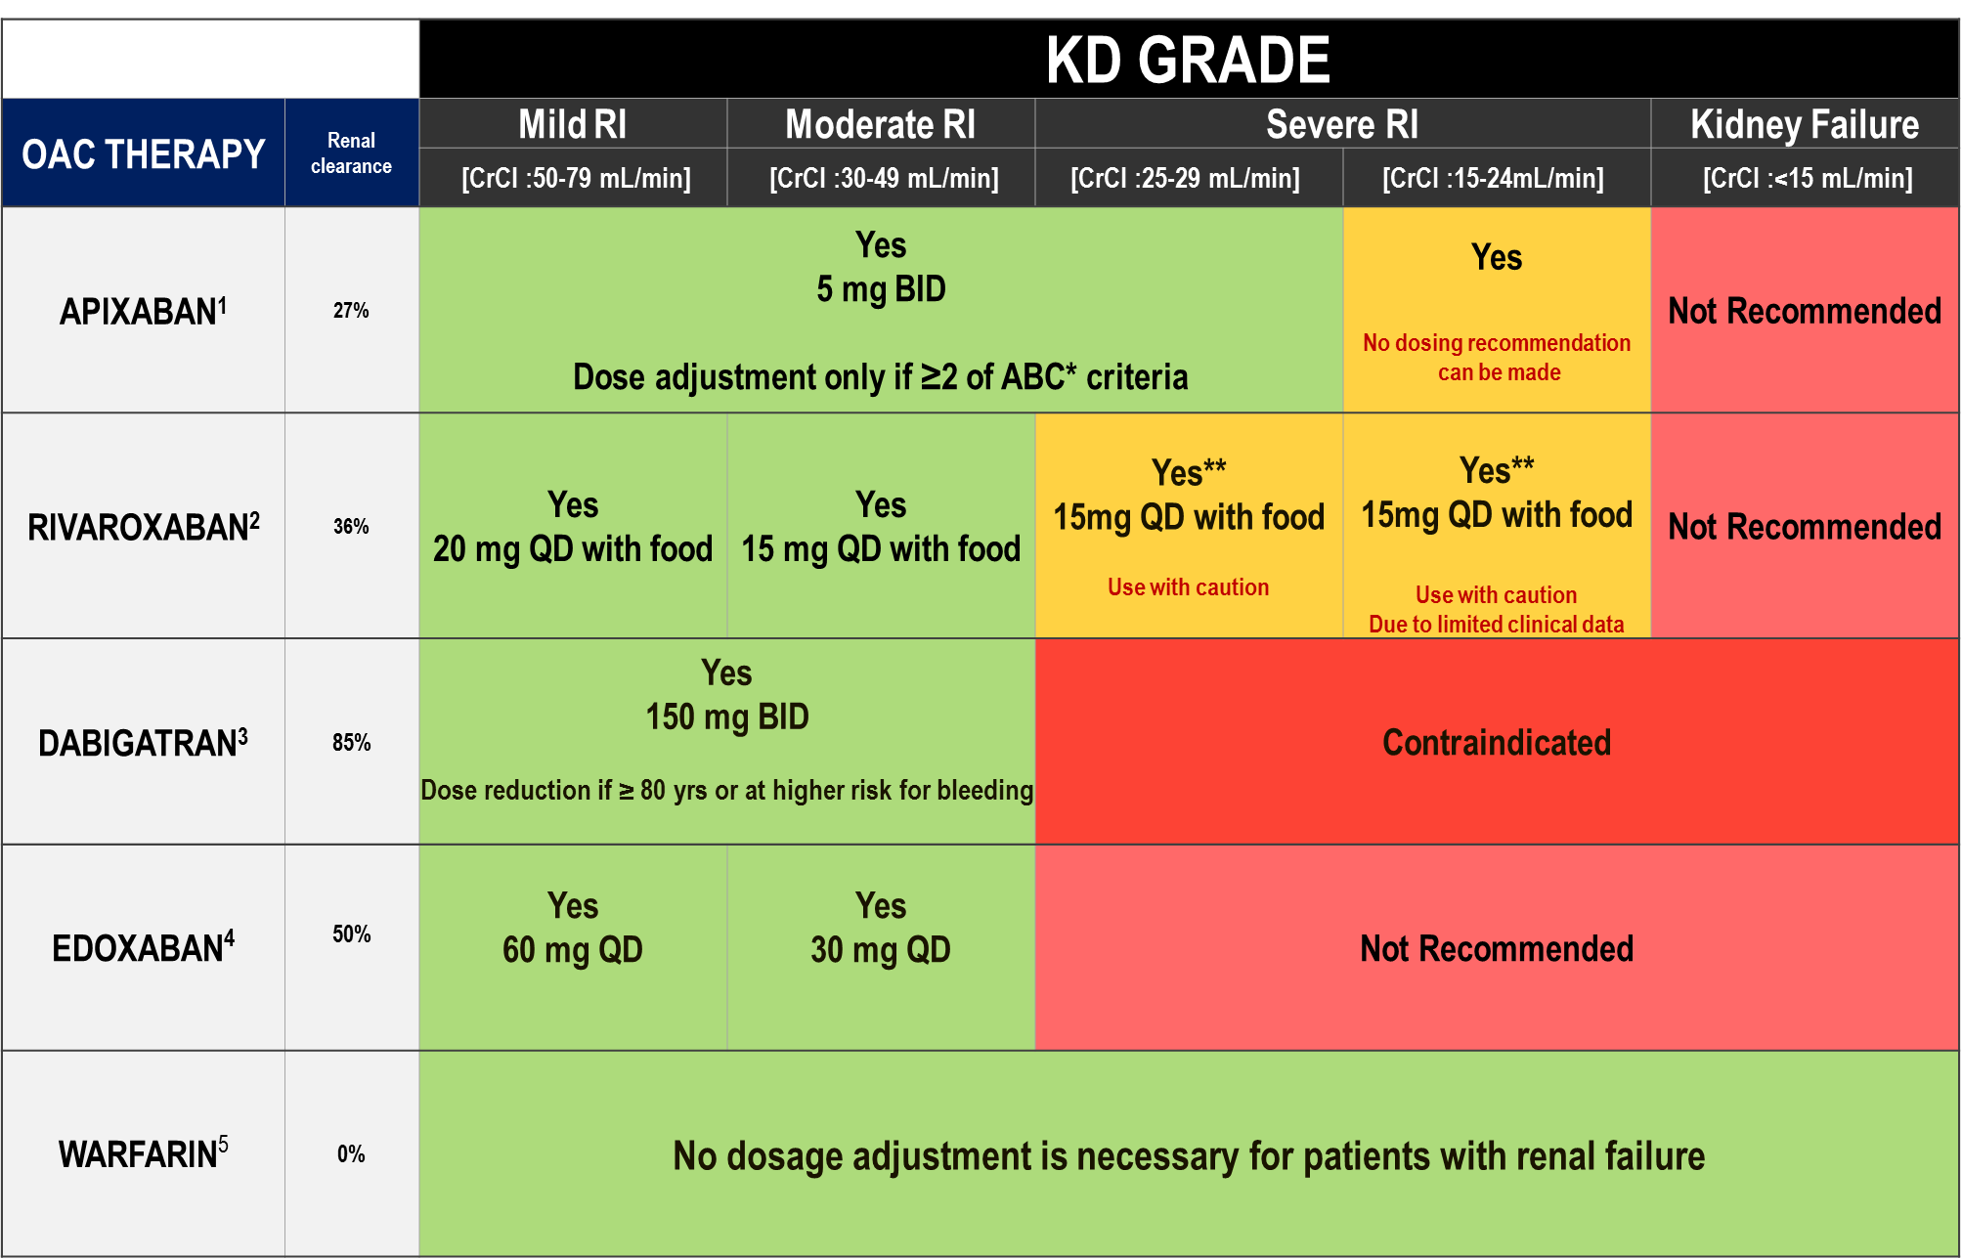
DOAC Dosing Recommendations for Stroke Prevention in AF in Patients with Renal Impairment According to the Canadian Product Monographs
Pfizer Canada Inc./BMS Canada. Eliquis (apixaban) Product Monograph, 2018.
Boehringer Ingelheim Canada Ltd. Pradaxa (dagbatran) Product Monograph. August 11, 2016.
Bayer Inc. Xarelto (rivaroxaban) Product Monograph. 2018.
Daiichi Sankyp Inc. Lixiana (edoxaban) Product Monograph. 2017.
Notes:
Speaker Notes:
Apixaban and Rivaroxaban can both be reasonable options for Melvin due to their lower renal clearance
Health Canada approved Rivaroxaban down to a CrCl of 15 ml/min in 2018 based on its pharmacokinetics
The FDA similarly approved Apixaban down to a CrCl of 15 ml/min
The CCS AF guidelines caution against the use of any DOAC below a CrCl of 30 ml/min due to exclusion of these CRF patients from the pivotal RCTs comparing DOACs with warfarin.

Slide 24
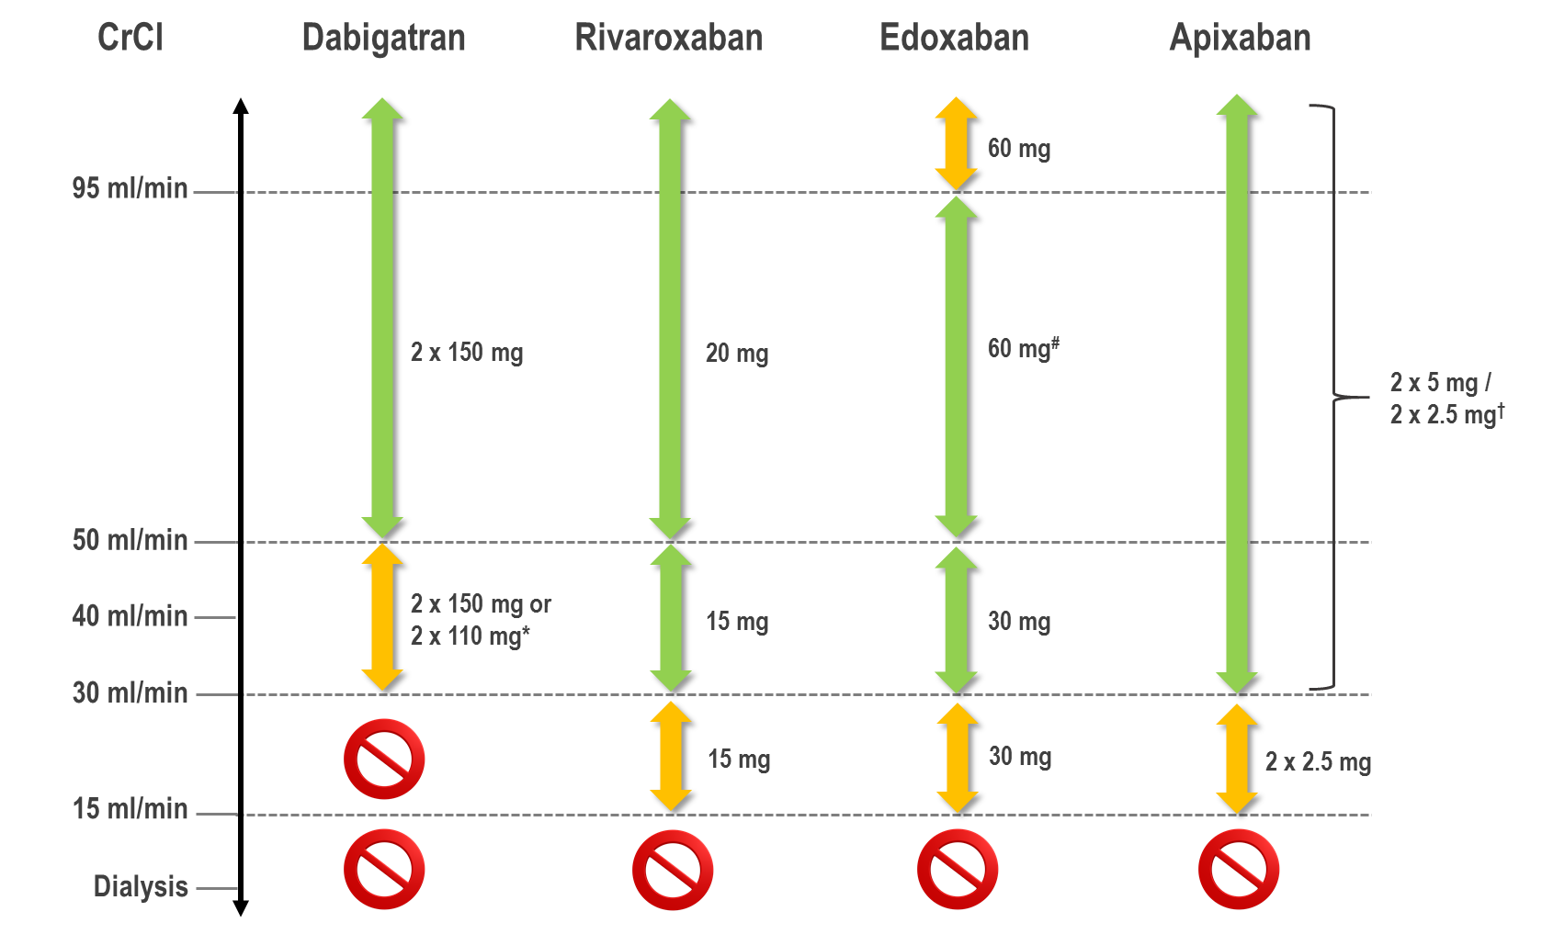
The 2018 European Heart Rhythm Association
Practical Guide on the Use Of DOACs in Patients
with Atrial Fibrillation
Steffel J. et al; European Heart Journal (2018) 39, 1330–1393
Notes:
Speaker Notes:
Use of non-vitamin K antagonist oral anticoagulants according to renal function. *2x 110 mg in patients at high risk of bleeding (per SmPc). # Other dose reduction criteria may apply (weight ≤60 kg, concomitant potent P-Gp inhibitor therapy) † 2x 2.5 mg only if at least two out of three fulfilled: age ≥80 years, body weight ≤60 kg’ creatinine ≥1.5 mg/dL (133 mmol/L). Orange arrows indicate cautionary use (dabigatran in moderate renal insufficiency, FXa inhibitors in severe renal insufficiency, edoxaban in ‘supranormal’ renal function);
Oral anticoagulant therapy in patients with a CrCl of 15–29 mL/min
There are no RCT data on the use of DOACs for stroke prevention in AF patients with severe CKD or on renal replacement therapy (RRT) since all landmark DOACs trials essentially excluded patients with a CrCl of <30 ml/min (except for a few patients on apixaban with CrCl 25–30 mL/min). However, VKA have also never been prospectively assessed in a RCT in this patient population
Rivaroxaban, apixaban, and edoxaban (but not dabigatran) are approved in Europe for the use in patients with severe CKD (Stage 4, i.e. a CrCl of 15–29 mL/min), with the reduced dose regimen. In view of the individual DOACs’ pharmacokinetics, dose-reduction criteria and available evidence from RCTs, the use of either apixaban or edoxaban may be preferable in these patients. Apixaban is least renally cleared (27%), and the dose is reduced by 50% in rather stringent conditions according to its dose reduction algorithm; furthermore the relative safety of apixaban vs. warfarin has been demonstrated to increase with decreasing renal function. Edoxaban is 50% renally cleared, but its dose reduction to 50% is applied more rapidly and was tested in a large subgroup. Rivaroxaban has an intermediate renal clearance (33%), and its dose is reduced less (by 25%) under similar conditions as edoxaban. In the US (but not in Europe), a low dose dabigatran 75 mg BID regimen has been approved for patients with severe CKD (a CrCl of 15–29 mL/ min), based on pharmacokinetic simulations. Further randomized trial data are urgently required for these difficult to treat patients.

Slide 25
Case 4
Another 3 years later. Melvin is now 76 years old and his
eGFR is < 15 mL/min/1.73 m²
Melvin feels well and is not receiving
renal replacement therapy.
Notes:
Speaker Notes:

Slide 26
How would you adjust Melvin’s anticoagulation strategy at this point?(eGFR < 15 )?
Select from one or more of the available options
Let Melvin know Warfarin is the safest option for his stage of chronic kidney disease
Use Dabigatran 150 mg BID
Use Dabigatran 110 mg BID
Use Apixaban 5 mg BID
Use Apixaban 2.5 mg BID
Use Edoxaban 60 mg OD
Use Edoxaban 30 mg OD
Use Rivaroxaban 20 mg OD
Use Rivaroxaban 15 mg OD
Do not use any anticoagulation as Melvin’s bleeding risk outweighs his risk of a cardioembolic event
Notes:
Speaker Notes:

Slide 27
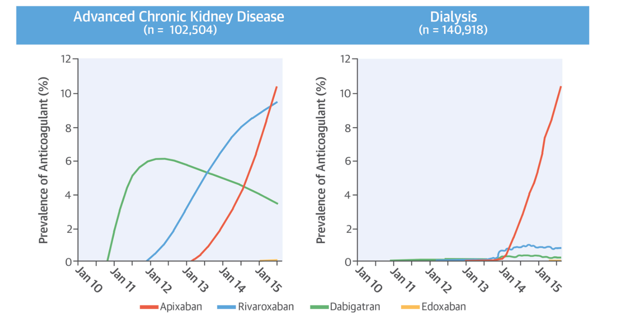
Use of Nonvitamin K-Dependent Oral Anticoagulant Agents in Patients With Advanced Chronic Kidney Disease and on Dialysis: Substantial and Growing
Chan, K.E. et al. J Am Coll Cardiol. 2016; 67(24): 2888-99
Notes:
Speaker Notes:
Patients with atrial fibrillation (AF) are increasingly being treated with nonvitamin K-dependent oral anticoagulant agents (DOACs) because these drugs are at least as effective as warfarin, are safer, do not require routine monitoring, and are simpler to use 1, 2, 3, 4, 5. In 2013, DOACs accounted for 62% of new prescriptions of anticoagulant agents in the United States, and their adoption is increasing (1).
Although DOACs hold great promise, they also have drawbacks, such as limited availability of and little experience with reversal agents, as well as higher costs. Currently, all DOACs depend to some extent on renal function for clearance. Consequently, DOACs may potentially accumulate in patients with renal dysfunction, leading to an increased risk for bleeding. Additionally, patients with advanced chronic kidney disease (CKD) (creatinine clearance [CrCl] <30 ml/min) are already at increased risk for bleeding from uremia-induced platelet dysfunction 6, 7. Patients on hemodialysis have added bleeding risks from repeated vascular access cannulation, dialysis membrane interactions, higher than average blood pressures, and considerable heparin administration during treatment. Because patients with advanced CKD and end-stage renal disease(ESRD) were excluded from all of the pivotal phase 3 DOAC trials, no randomized controlled trial data guide DOAC use when the CrCl is <25 ml/min, although the U.S. Food and Drug Administration (FDA) label supports DOAC dosing for patients with CrCl ≤15 ml/min.
The most recent 2014 American Heart Association (AHA), American College of Cardiology (ACC), and Heart Rhythm Society (HRS) guideline for the management of patients with AF recommends warfarin as the anticoagulant agent of choice in patients with advanced CKD or ESRD (8). Despite these recommendations and the lack of prospective trials to validate the efficacy and safety of DOACs in this patient population, the prescription of these drugs is becoming more prevalent, as we showed in our previous publication (9). Our updated analysis (unpublished data from Fresenius Medical Care) indicates that there were 102,504 AF patients with advanced CKD and 140,918 AF patients on dialysis treated with an oral anticoagulant in the Fresenius database. As of October 2015, 23.5% of CKD patients and 11.6% of dialysis patients on anticoagulation were treated with a DOAC (Central Illustration). In advanced CKD, the most commonly used drug was apixaban (10.4%), followed by rivaroxaban (9.5%), dabigatran (3.5%), and edoxaban (0.1%). Among dialysis patients, the most commonly used drug was apixaban (10.5%), followed by rivaroxaban (0.8%), dabigatran (0.3%), and edoxaban (0.01%).

Slide 28
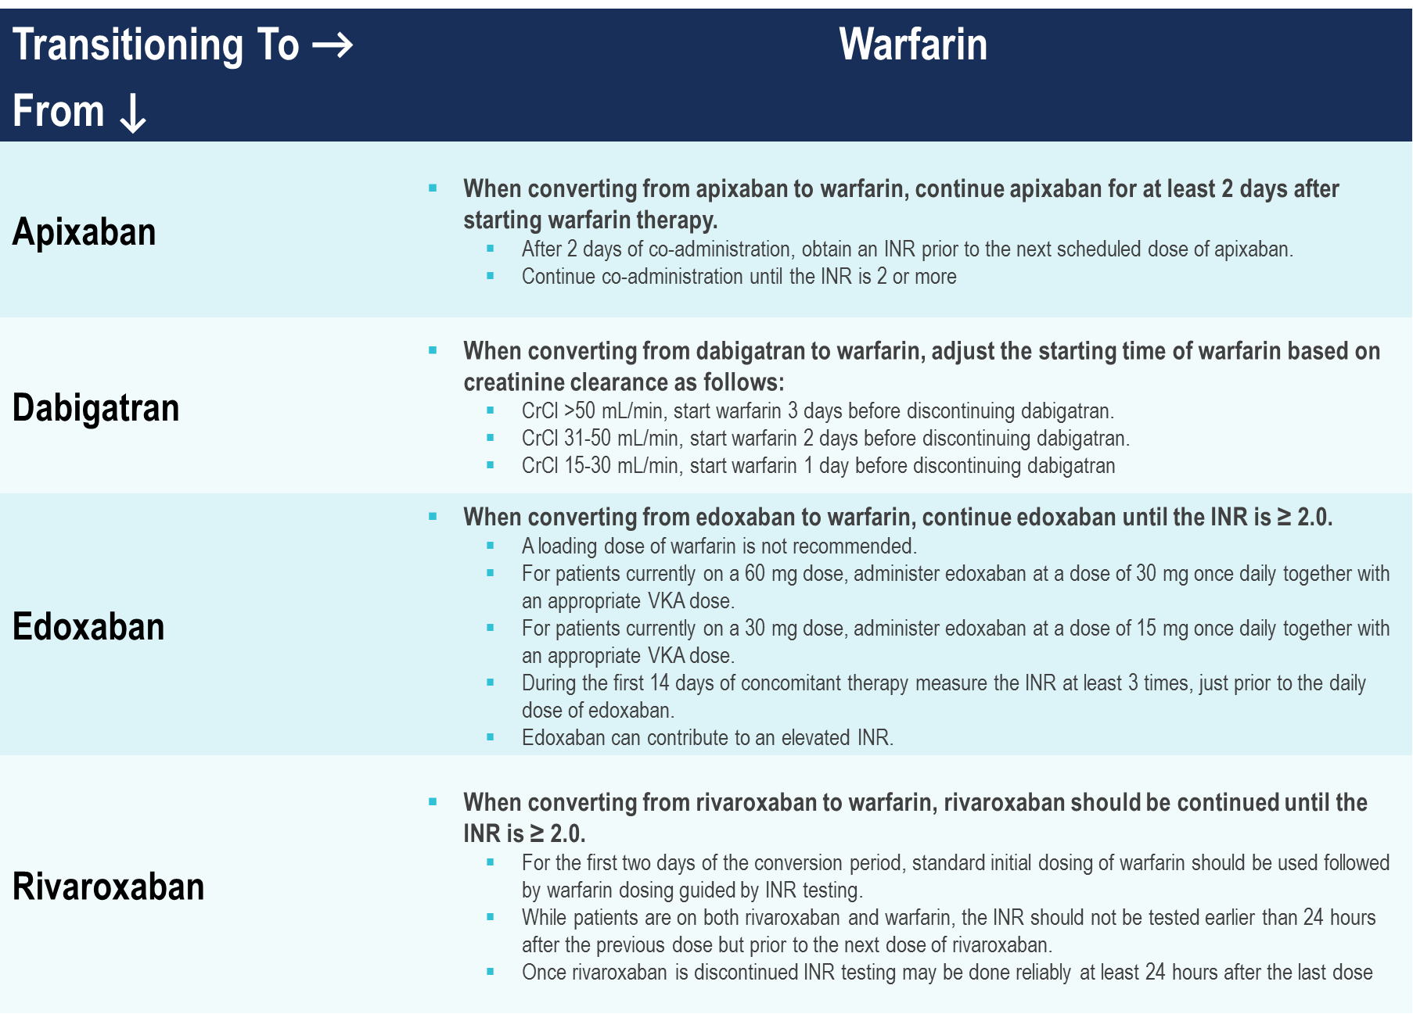
Transitioning from DOACs
to Warfarin
Pfizer Canada Inc./BMS Canada. Eliquis (apixaban) Product Monograph, 2018.
Boehringer Ingelheim Canada Ltd. Pradaxa (dagbatran) Product Monograph. August 11, 2016.
Bayer Inc. Xarelto (rivaroxaban) Product Monograph. 2018.
Daiichi Sankyp Inc. Lixiana (edoxaban) Product Monograph. 2017.
Notes:
Speaker Notes:
Transitioning from a DOAC to warfarin requires bridging.
Encourage the group to review the product monograph prior to switching.

Slide 29
Major Bleeding Rates with Warfarin is Increased in Low CrCl Patients
Kidney Function | Major Bleeding (Events per 100 Patient-Years)
CrCl ≥60 ml/min | 6.2 (4.1–8.9)
CrCl 30–59 ml/min | 8.3 (5.1–12.8)
CrCl <30 ml/min | 30.5 (17.0–50.3)
Dialysis | 54–100
CrCl = creatinine clearance.
Chan, K.E. et al. J Am Coll Cardiol. 2016; 67(24): 2888-99
Notes:
Speaker Notes:
Data from Limdi et al. (17) and Elliott et al. (64).
Warfarin is minimally dependent on the kidney for elimination, such that progression of CKD or acute changes in creatinine can minimally influence anticoagulation levels from the drug. Warfarin has the advantages of clinical familiarity, low cost, and widespread availability of reversal agents. Reversal of warfarin’s anticoagulant effect can be accomplished with vitamin K or fresh-frozen plasma for nonemergent situations, with 4-factor prothrombin complexes recommended for life-threatening bleeding (22). Warfarin significantly increases the risk for bleeding as CrCl decreases. This is likely secondary to superimposed platelet dysfunction from worsening uremia. A patient on warfarin with CrCl <30 ml/min has a 4.9-fold (95% confidence interval [CI]: 2.6 to 9.1) increased relative risk for bleeding compared with patients on warfarin without renal disease

Slide 30

What about End Stage Renal Disease?
CrCl < 15 ml/min
Notes:
Speaker Notes:

Slide 31
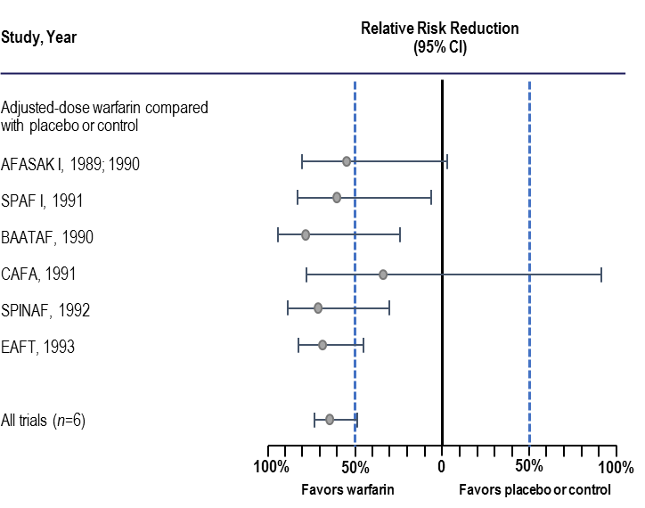
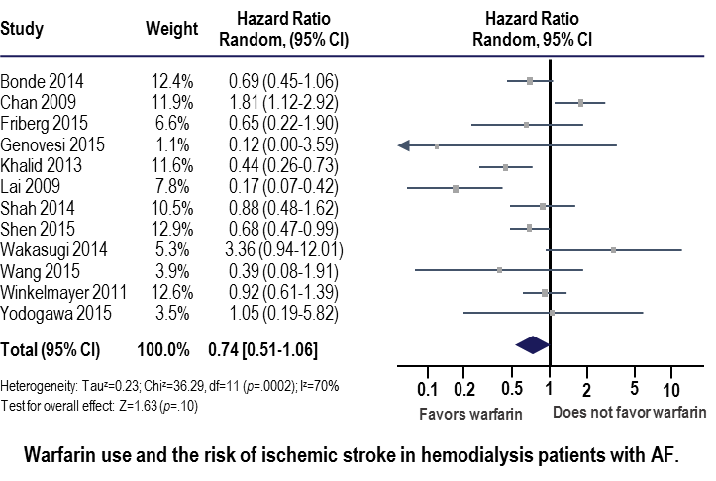
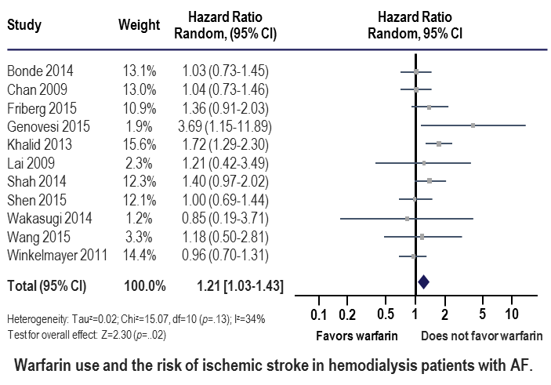
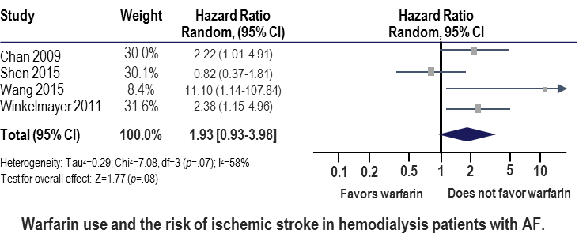
Warfarin Use in ESRD*
26% ↓ ischemic stroke
Compared to 64% ↓ ischemic stroke
in Non-ESRD patients
21% ↑ major bleeding
93% ↑ intracranial hemorrhage
Am Heart J 2017; 184:37-46.
Notes:
Speaker Notes:
Slide has transitions
1st - Compared to 64% ↓ ischemic stroke in Non-ESRD patients
2nd - 21% ↑ major bleeding
3rd - 93% ↑ intracranial hemorrhage

Slide 32

Key Messages
Appropriate anticoagulation treatment should be started in the vast majority of AF patients as per the CCS guidelines
DOACs offer several advantages over warfarin, and should generally be used in preference to warfarin for SPAF for eGFR > 30 ml/min/1.73m²
DOACs with low renal clearance such as apixaban or rivaroxaban can be considered for SPAF in patients with an eGFR 15-30 ml/min/1.73m²
In patients with CKD, eGFRs should be followed closely and other patient characteristics and co-morbidities (age, etc…) should be considered when selecting and dosing DOACs
Notes:
Speaker Notes:

Slide 33
Backup Slides

Slide 34
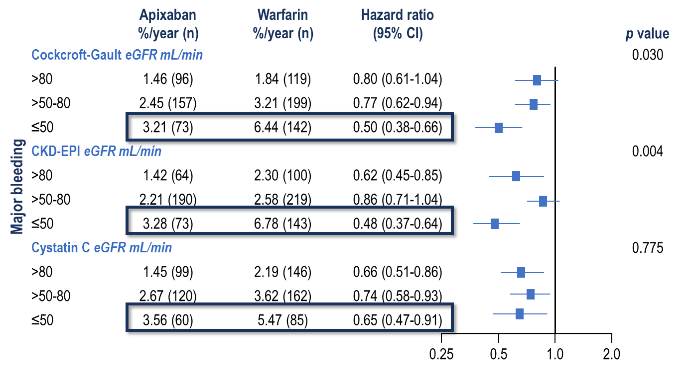
Patients with Impaired Renal Function and Major Bleeding: ARISTOTLE
Hohnloser et al. Eur Heart J 2012; 33:2821-30.
Notes:
Speaker Notes:
Why novel OACs should be first line V – counterarguments misconceptions:
Renal dysfunction dangerous
Aims Atrial fibrillation (AF) is common among patients with impaired renal function. Apixaban, a novel oral anticoagulant with partial renal excretion, was compared with warfarin and reduced the rate stroke, death and bleeding in the ARISTOTLE trial. We evaluated these outcomes in relation to renal function.
Methods and results
Baseline glomerular filtration rate (GFR) was estimated using the Cockcroft–Gault and Chronic Kidney Disease
Epidemiology Collaboration (CKD-EPI) equations as well as cystatin C measurements. According to baseline Cockcroft–Gault, there were 7518 patients (42%) with an estimated GFR (eGFR) of .80 mL/min, 7587 (42%) between .50 and 80 mL/min, and 3017 (15%) with an eGFR of ≤50 mL/min. The rate of cardiovascular events and bleeding was higher at impaired renal function (≤80 mL/min). Apixaban was more effective than warfarin in preventing stroke or systemic embolism and reducing mortality irrespective of renal function. These results were consistent, regardless
of methods for GFR estimation. Apixaban was associated with less major bleeding events across all ranges of eGFRs.
The relative risk reduction in major bleeding was greater in patients with an eGFR of ≤50 mL/min using Cockcroft–
Gault {hazard ratio (HR) 0.50 [95% confidence interval (CI) 0.38–0.66], interaction P ¼ 0.005} or CKD-EPI equations
[HR 0.48 (95% CI 0.37–0.64), interaction P ¼ 0.003].
Conclusion
In patients with AF, renal impairment was associated with increased risk of cardiovascular events and bleeding. When compared with warfarin, apixaban treatment reduced the rate of stroke, death, and major bleeding, regardless of renal function. Patients with impaired renal function seemed to have the greatest reduction in major bleeding with apixaban.
GFR is an accepted index of renal function. Several equations exist to noninvasively estimate GFR from serum creatinine. The Cockcroft-Gault equation is at present the most widely used; however, it systematically overestimates GFR.21 The CKD-EPI equation was developed to more accurately estimate GFR across all ranges of renal function.14 The qualities of the different equations are evident in the differences regarding number of subjects classified with eGFR ≥80 mL/min or eGFR 50 to <80 mL/min between the Cockcroft-Gault and CKD-EPI equations. The majority of reclassification occurred in the group estimated as having normal renal function according to the Cockcroft-Gault equation. Approximately 50% of the participants, 3030 of 5844, estimated as having renal function ≥80 mL/min with the Cockcroft-Gault were classified as having GFR <80 mL/min with the CKD-EPI equation. The more accurate estimation of individuals’ renal function and reclassification achieved with the CKD-EPI equation appear to account for the more pronounced patterns and narrower confidence intervals in the renal function interaction analyses with regard to dabigatran relative to warfarin for the safety outcomes. Use of the cystatin C equation is not well described in elderly populations and was only available in a subset of patients (n=6190); consequently, the results need to be interpreted with some caution. However, similar patterns concerning eGFR classification and treatment interactions have been described recently in a large AF population from the Apixaban for Reduction in Stroke and Other Thromboembolic Events (ARISTOTLE) trial.6 On the basis of the present results, it appears that the CKD-EPI equation provides important and clinically useful information regarding the assessment of renal function and the tailoring of oral
anticoagulation in AF.
Background—Renal impairment increases the risk of stroke and bleeding in patients with atrial fibrillation. In the
Randomized Evaluation of Long-Term Anticoagulant Therapy (RELY) trial, dabigatran, with ≈80% renal elimination, displayed superiority over warfarin for prevention of stroke and systemic embolism in the 150-mg dose and significantly less major bleeding in the 110-mg dose in 18 113 patients with nonvalvular atrial fibrillation. This prespecified study investigated these outcomes in relation to renal function.
Methods and Results—Glomerular filtration rate was estimated with the Cockcroft-Gault, Chronic Kidney Disease
Epidemiology Collaboration (CKD-EPI), and Modification of Diet in Renal Disease (MDRD) equations in all randomized patients with available creatinine at baseline (n=17 951), and cystatin C–based glomerular filtration rate was estimated in a subpopulation with measurements available (n=6190). A glomerular filtration rate ≥80, 50 to <80, and <50 mL/min was estimated in 32.6%, 47.6%, and 19.8% and in 21.6%, 59.6%, and 18.8% of patients based on Cockcroft-Gault and CKD-EPI, respectively. Rates of stroke or systemic embolism, major bleeding, and all-cause mortality increased as renal function decreased. The rates of stroke or systemic embolism were lower with dabigatran 150 mg and similar with 110 mg twice daily compared with warfarin, without significant heterogeneity in subgroups defined by renal function
(interaction P>0.1 for all). For the outcome of major bleeding, there were significant interactions between treatment and renal function according to CKD-EPI and MDRD equations, respectively (P<0.05). The relative reduction in major bleeding with either dabigatran dose compared with warfarin was greater in patients with glomerular filtration rate ≥80mL/min.
Conclusions—The efficacy of both dosages of dabigatran was consistent with the overall trial irrespective of renal function.
However, with the CKD-EPI and MDRD equations, both dabigatran dosages displayed significantly lower rates of major
bleeding in patients with glomerular filtration rate ≥80 mL/min.
Clinical Trial Registration—URL: http://www.clinicaltrials.gov. Unique identifier: NCT00262600.
(Circulation. 2014;129:961-970.)

Slide 35
Pharmacokinetics of Nonvitamin K-Dependent Oral Anticoagulant Agents
Chan J Am Coll Cardiol 2016;67:2888-99
Notes:
Speaker Notes:

Slide 36
Renal Factors and Outcomes with OACs in Patients with AF and Mild-Moderate Renal Failure
Chan J Am Coll Cardiol 2016;67:2888-99
Notes:
Speaker Notes:

Slide 37
Impact of Renal Function on Edoxaban Exposure
Group 1: CrCL > 80 mL/min without renal disease
Group 2: CrCL 50 to 80 mL/min
Group 3: CrCL 30 to 49 mL/min
Group 4: CrCL < 30 mL/min not on dialysis
Group 5: Peritoneal Dialysis/End Stage Renal Disease
Lower limit of quantitation (1.0 ng/ml)
 | CrCL > 80 mL/min without renal disease | CrCL 50 to 80 mL/min | CrCL 30 to 49 mL/min | CrCL < 30 mL/min not on dialysis | Peritoneal Dialysis/End Stage Renal Disease
Change in Edoxaban AUC₀₋∞ compared to CrCL > 80 mL/min | - | 32% | 74% | 72% | 93%
Need 50% dose reduction
Ridout G,et al. Effect of renal function on edoxaban pharmacokinetics (PK) and on population PK/PD model. J Clin Pharmacol 2009;49:1091-130.
Notes:
Speaker Notes:

